Slide 1
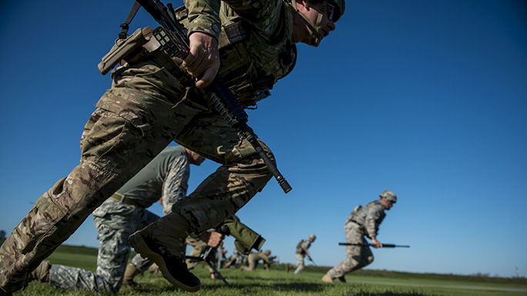
NDHQ Marksmanship Team - Kickoff

Slide 2
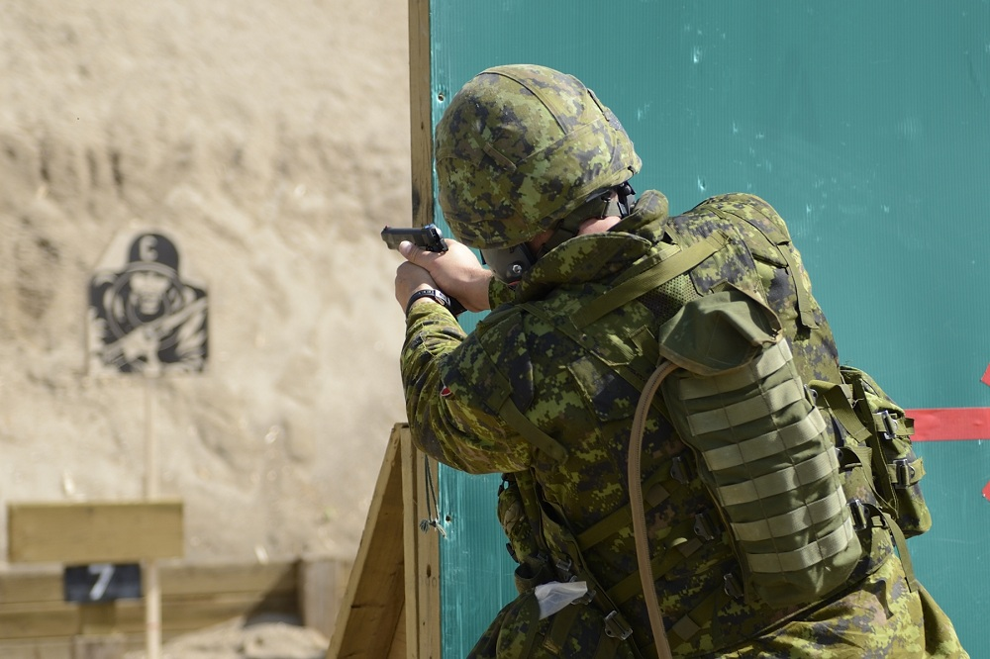
Agenda
Team Intro.
CAFSAC – What is it?
Marksmanship Principles.
Equipment.
What to expect.

Slide 3
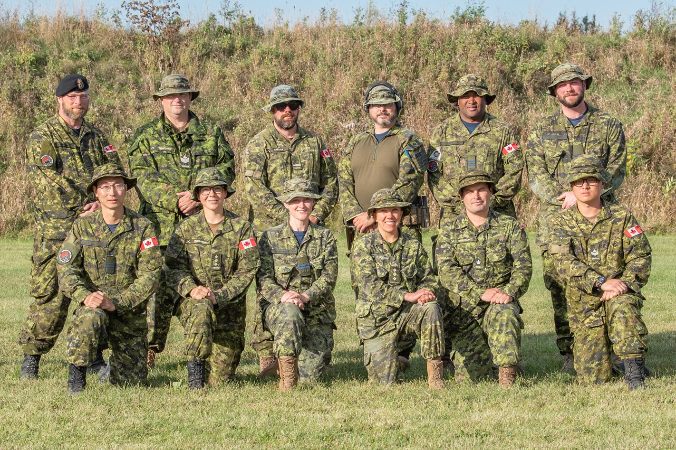
Team Intro
NDHQ CAFSAC Team 2019

Slide 4
Team Intro
Team Captain – PO 1 Cameron, Byron
Team Ammo Rep – Capt Leung, Henry
Team Log O – MCpl Ki, Jin
RSOs
Capt Henry Leung
WO Lukas “Red” Rediger
Capt Locking, Breanne
Capt McAtamney, Julie
Rest of the team alumni – ARSOs
Coaches – CPO1 Cashin, Marty and WO Foster, Luke

Slide 5
CAF Small Arms Concentration What is it?
2 week competition Approximately 1-2 Week of Sept.
300+ competitors.
Several nations competing.
Reserve, Ranger and Regular Force Classes.
CAFSAC Participants 2019

Slide 6
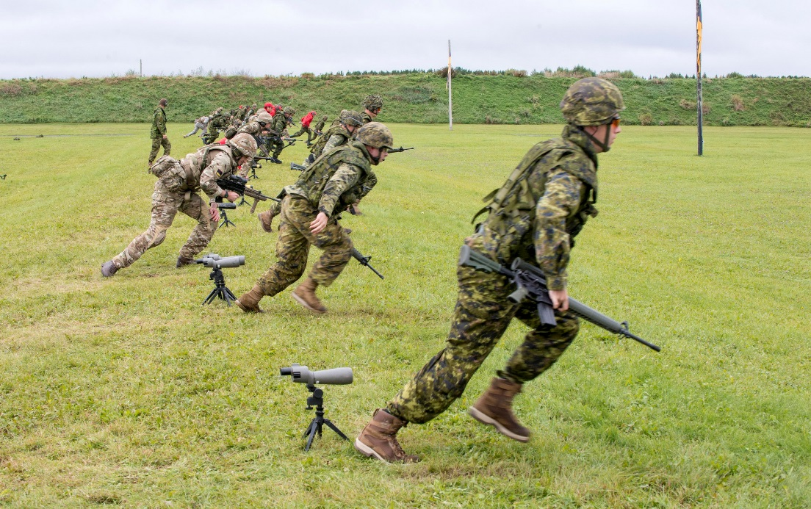
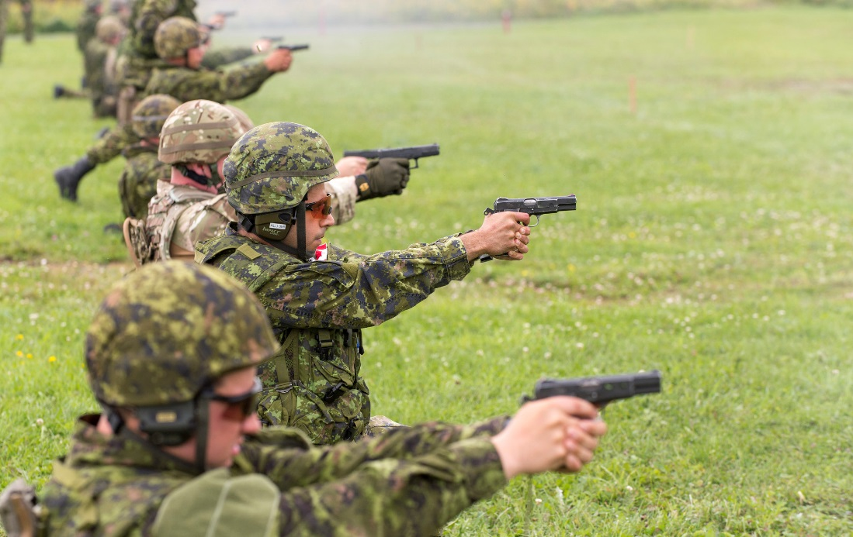
CAFSAC What is it?
NDHQ team focuses on Rifle, Pistol, and possibly Machine Gun.
We do not compete as a team for CASAM (obstacle course, 10K run etc.), though some events may be an option for those interested.

Slide 7
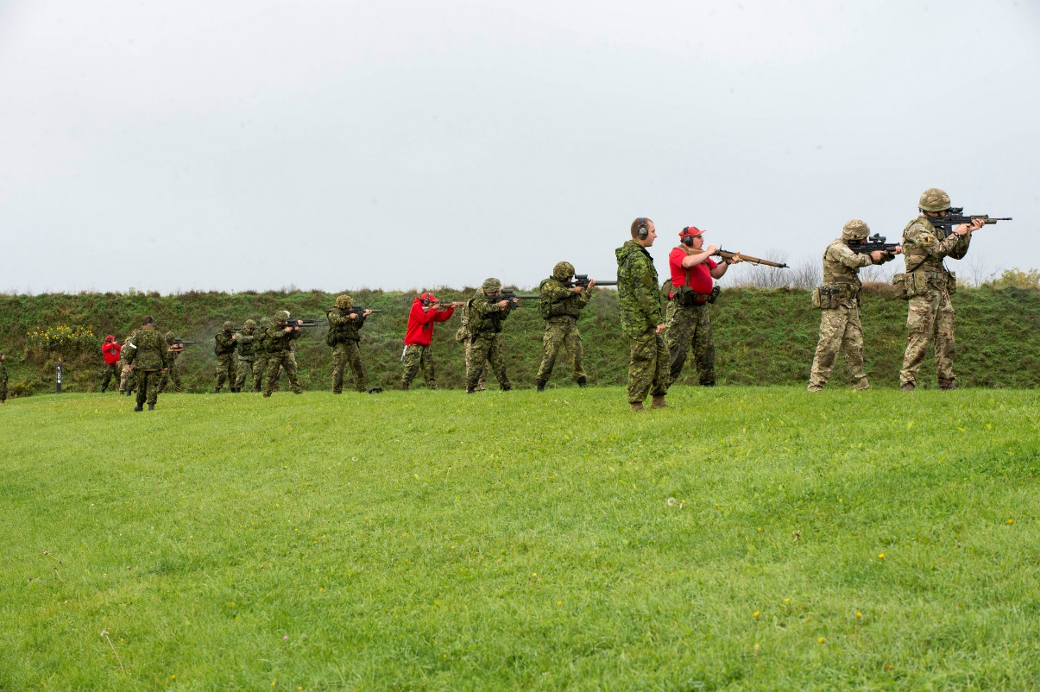
CAFSAC What is it?
Rifle has 4 primary matches to qualify for Queens Medal match (only top 50 from Canada compete for QM)
Match 11: 200m, 100m, Deliberate prone, Rapid, Rundown – General marksmanship skills
Match 12: 100m and less, Movers, Snaps, Standing/kneeling – Target acquisition, trigger control

Slide 8
CAFSAC What is it?
Match 13: 300m, 200m, 100m, Deliberate prone, Agony Prone, rundowns, movers, rapids – General skills, Response time/awareness
Match 14: 500m, 400m, 300m, 200m, 100m, Deliberate prone, rundowns, movers, rapids – Long distance skills (wind gauging, sight adjustment, trigger/breathing control), cardio

Slide 9
CAFSAC What is it?
Other matches:
Night Shoot – 100m and less, NVGs with Lasers. Only a Fun shoot for us, but still possibility of medals.
Barrier Shoot – Shoot around/over walls. Fun Shoot.
Falling Plates – Rundown with 10 falling plates per team of 4. Compete against another team of 4. Fun shoot.

Slide 10
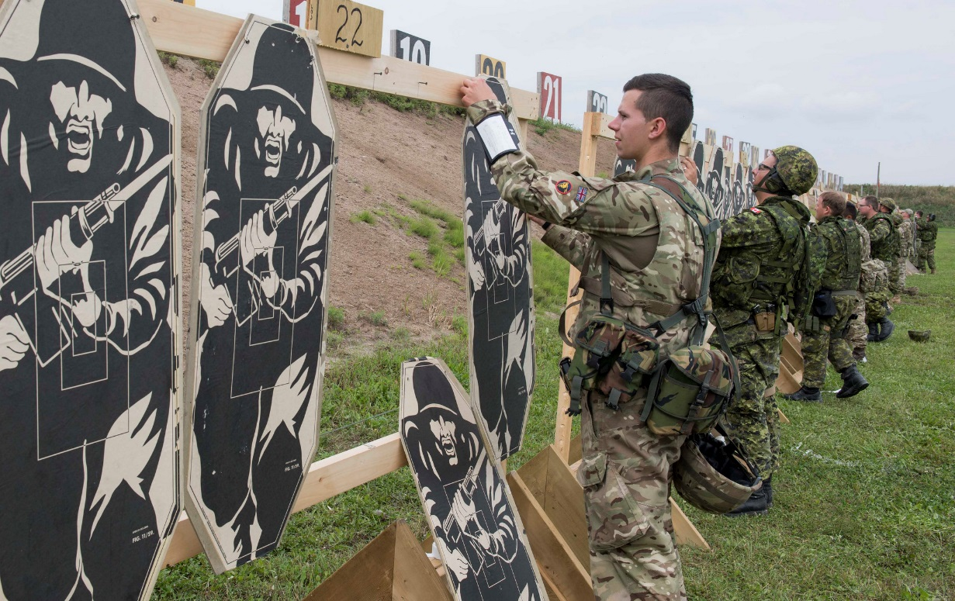
CAFSAC What is it?
Pistol has 3 primary matches and 2 (or more) CQB matches
Match 21, 22, and 23 are matches with tight times, a variety of distances and some one handed left/right shooting. Self directed reloads will be part of the competition as well.

Slide 11
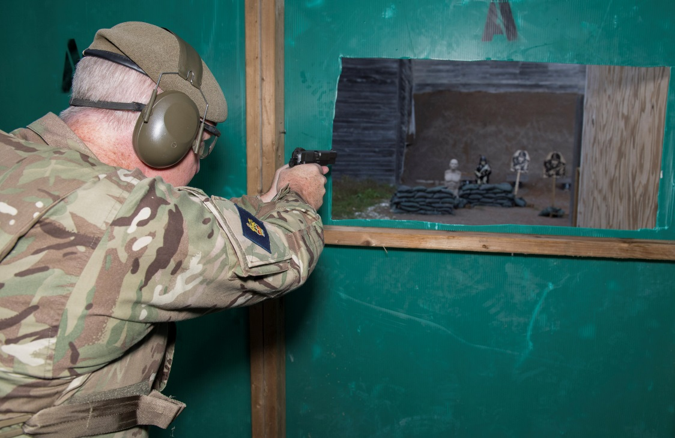
CAFSAC What is it?
CQB matches are time based with penalties for inaccuracy, failure to reload tactically, failure to engage a target, failure to use cover, and minor safety infractions.

Slide 12
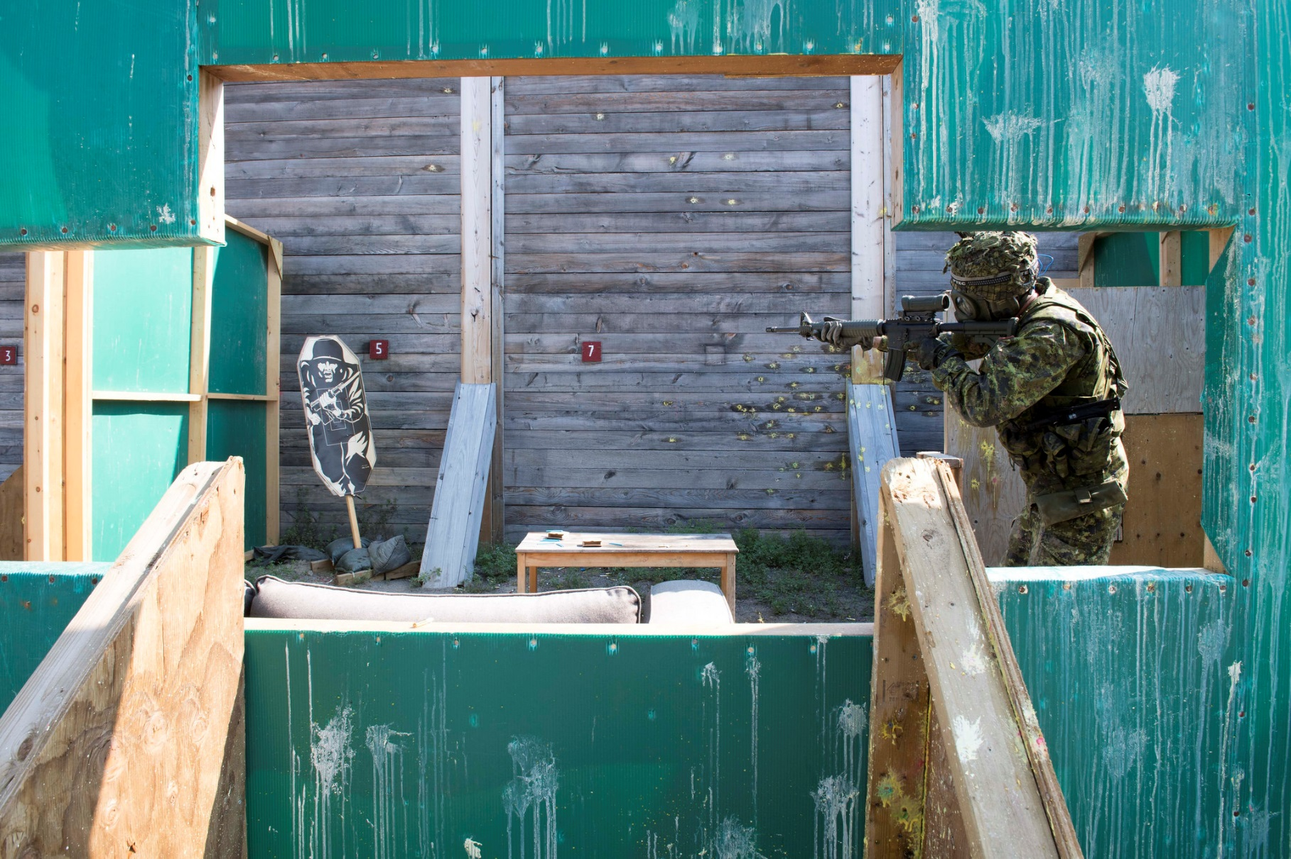
CAFSAC What is it?
2 way range with Simunition and paintball turrets may be a CQB match.
Paintballs!!!!

Slide 13
International Competitions
The results from CAFSAC may determine which CAF members will be selected to join the CAF Combat Shooting Teams the following year in three international shooting competitions.
AFSAM (Armed Forces Skill At Arms Meeting). Held each year at the National Guard Marksman ship training center in Little Rock Arkansas. Chosen from the top combined rifle/pistol shooters.
AASAM (Australian Army Skill at Arms Meeting). Selected from top C9 team and the rest from CASAM.
Bisley, Held in the UK. CAF sends two teams one reserve, one regular force. Members are selected from matches 11-15 in service rifle.

Slide 14
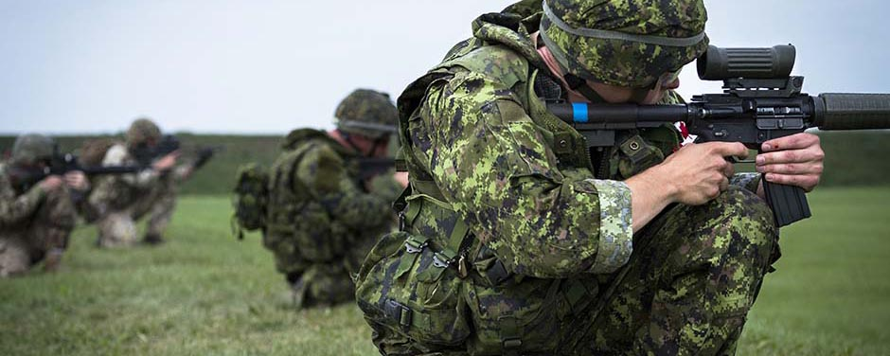
Marksmanship Principles
2 Components:
The Science
The Skill

Slide 15
Marksmanship Principles
Key Terminology
Precision – The ability to control factors that affect shot pattern (Grouping Size).
Minimize instability, Estimate Wind, Comprehend temperature/pressure, etc.
Accuracy – The ability to consistently place shots on your point of aim.
Hit what you’re aiming at.
Point of Aim – POA – The place on a target you are aiming at.
Point of Impact – POI – The place on a target you actually hit.

Slide 16
Marksmanship Principles The Science
Minute of Angle – M.O.A.
Derived from imperial measurements of Degrees, Minutes, Seconds of angle (rather than Mils).
Angle of uncertainty between point of aim and point of impact
Results in a “grouping” of impacts.
C7 capable of 1 MOA which is approximately 1” at 100yards (close enough to 1” at 100m).
Angle of uncertainty is consistent at all distances. Factors such as wind and bullet drop have minimal effect on “grouping” size.
Gauge of Precision.
300m
200m
100m
1”
2”
3”

Slide 17
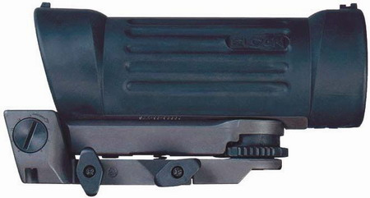
Marksmanship Principles The Science
C-79 Sight
Each “click” is approx. 1” at 100m (technically, .85MOA)
Elevation
Two disks:
1. Pre defined distances (rough estimates)
2. Zero disk with fine adjustment to set the Sight zero
Unlike Windage disk, UP has an indicated direction
Windage
Requires a Quarter or similar washer to adjust!
Arrow points in direction to adjust to RIGHT
Disk Lock
“gate” should be up to adjust the Fine disk independently from the pre set disk
Mounting Screws
Uses Mil Std 1913 mount
Keep Tight!

Slide 18
Marksmanship Principles The Science
C-79 Sight cont’d
3.7x magnification.
Reticle has a 70mm Eye Relief so sight needs to have its position on the C7 adjusted based on shooter’s ergonomics.
Incorrect eye position will result in PARALLAX.
Parallax is the difference between perceived POA and POI.
Zero Parallax means POA and POI are the same.

Slide 19
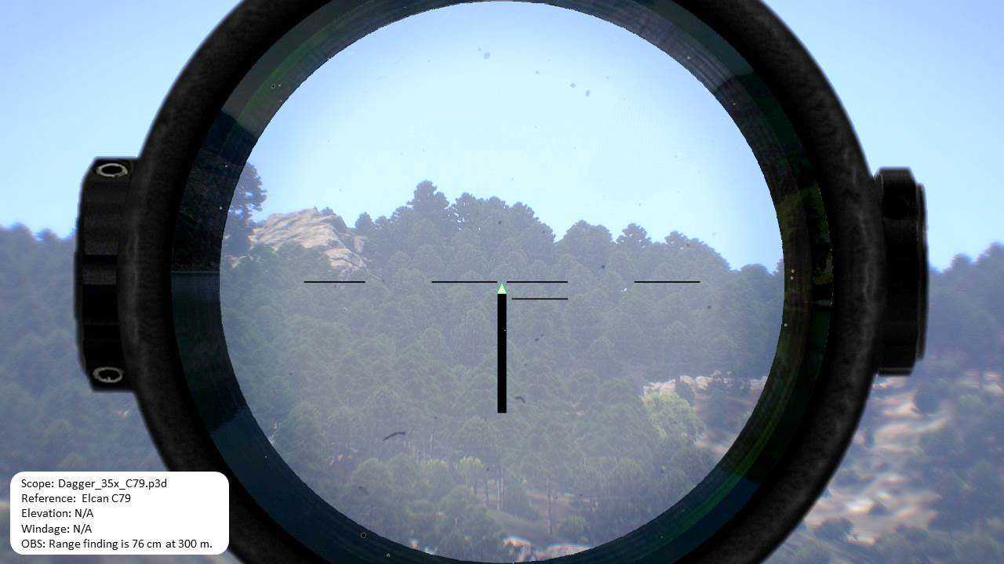
Marksmanship Principles The Science
C-79 Sight cont’d
Sight picture will tell you whether your eye is correctly positioned behind the sight.
Good Eye Relief
Poor Eye Relief
Zero Parallax – Consistent shots
- Good PRECISION
Parallax – will shift between shots – Inconsistent
- Poor PRECISION

Slide 20
Marksmanship Principles The Science
Windage
Wind has minimal effect from 0-100m.
Each subsequent 100m has greater effect assuming constant wind.
1. Gauge Wind Speed
2. Find Drift for speed at distance
Wind Speed (kph) | Description
<1 | Smoke rises vertically
2-5 | Direction of wind shown by smoke drift
6-11 | Wind felt on face
12-19 | Wind extends light flag
20-29 | Raises dust and loose paper
30-38 | Small trees in leaf begin to sway
39-50 | Large branches in motion
51-60 | Whole trees in motion; inconvenience felt in walking against wind
61-70 | Slight structural damage
71-85 | Trees uprooted
Wind Drift in INCHES
 | Range in metres
Wind Speed (kph) | 200 | 300 | 400 | 500
5 | 2 | 4 | 8 | 14
10 | 3 | 8 | 15 | 26
15 | 5 | 12 | 22 | 38
20 | 6 | 15 | 29 | 50
25 | 8 | 19 | 37 | 62
30 | 10 | 23 | 44 | 74

Slide 21
Marksmanship Principles The Science
Windage (cont’d)
3. Multiply Drift by ratio based on Direction.
4. Apply windage to Sight.
0
Remember: Wind is usually referred to by direction it is coming FROM. Adjust windage to SAME direction.
IE: Wind is coming from the LEFT, adjust sights to the LEFT.
0.5
0.5
1
1
0.5
0
0.5

Slide 22
Marksmanship Principles The Science
Elevation
Bullets reduce velocity over distance so rate of drop increases.
Elevation of sight is adjusted to compensate.

Slide 23
Marksmanship Principles The Science
C7 with Military ammo (62gr ss109 bullet)
Bullet drop increases significantly over distance.
Specific adjustment may change based on shooter, position and rifle.
Elevation also needs to be adjusted based on barometric pressure.
Generally follows the rule of “Sun’s Up Sights Up” adding 1 extra click of elevation on sunny warm days.
Distance (m) | Drop in Inches | # Clicks adjustment (from 100m Zero)
100 | 0 | 0
200 | 2 | 1
300 | 9 | 3
400 | 24 | 6
500 | 50 | 10

Slide 24
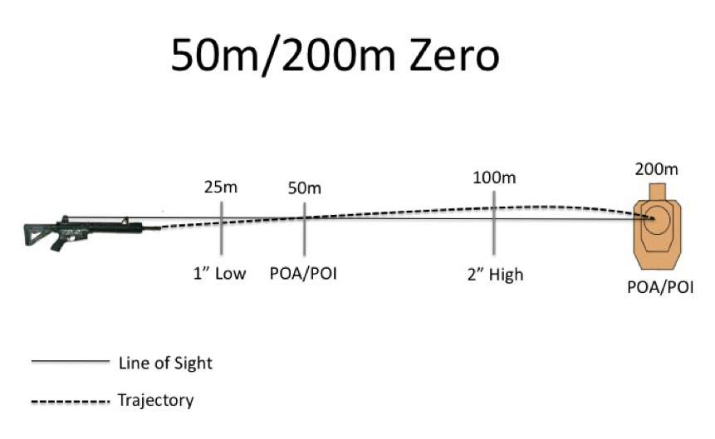
Marksmanship Principles The Science
At ranges closer than 100m, the distance between the center of the rifle bore and the center of the sight affects Accuracy.
Adjust elevation to longer distances to compensate.

Slide 25
Marksmanship Principles The Skill
5 Key elements
Breathing
Trigger Control
Position
Point of Aim
Knowledge

Slide 26
Marksmanship Principles The Skill
Breathing
Generally best to take a full breath and exhale about half before steadying for shot.
Trigger Control
Trigger should be either on the pad of your finger or near first joint.
With an empty hand, curl your finger closed and look for which part of your finger goes straight back, rather than curving.
Both of these skills affect Precision.

Slide 27
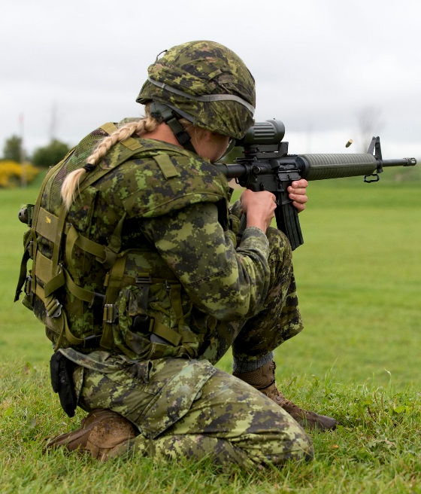
Marksmanship Principles The Skill
Position
Probably the second most important skill!
A good position is necessary for Precision – Stability and relaxed body significantly reduce uncertainty.
Requires flexibility and endurance developed over training season.

Slide 28
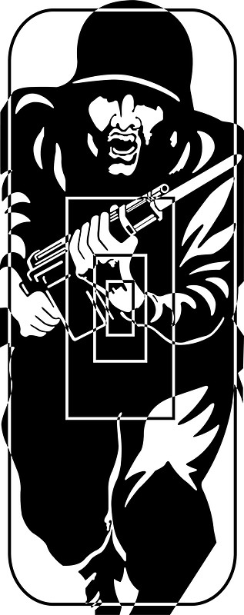
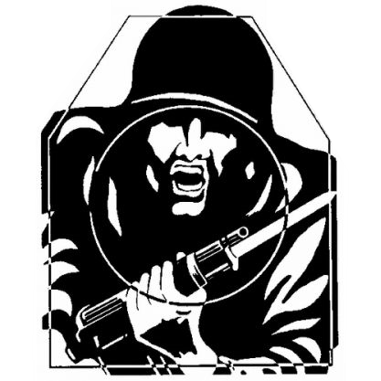
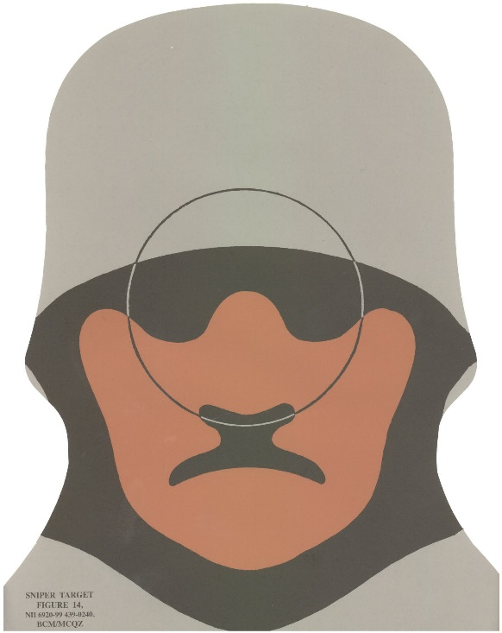
Marksmanship Principles The Skill
Point of Aim – The most important skill to develop
Point of aim changes depending on target, exposure type, and personal preference.
Stationary Point of Aim

Slide 29
Marksmanship Principles The Skill
Point of Aim Cont’d
Moving targets point of aim depends on distance, type of target and direction of movement.
Target moving LEFT
Target moving RIGHT
200m
200m
300m
300m

Slide 30
Marksmanship Principles The Skill
Point of Aim Cont’d
Target moving LEFT
Target moving RIGHT
Target moving LEFT
Target moving RIGHT
50m
50m
100m
100m

Slide 31
Marksmanship Principles The Skill
Point of Aim Cont’d
Aim Small Miss Small!
Highly recommended to select a point of aim where there is a distinct border between colours on the target rather than the middle of a larger pattern.
Reduce the size of your point of aim and your Precision will increase.
Good Point of Aim
Bad Point of Aim
Point of Impact
Point of Impact

Slide 32
Marksmanship Principles The Skill
Knowledge
CAFSAC range instructions, words of command are minimal.
Each competitor is obliged to know each stage of each match ahead of time.
Only instruction: “Match X, Load, Ready. Watch and Shoot”.
Mental Mantra prior to each stage:
Safety, Sights, Wind, Prepare to move.

Slide 33
Marksmanship Principles The Skill
Knowledge Cont’d
Safety – Magazine for next stage loaded, readied, safety ON.
Sights – Adjust elevation for next stage.
Wind – Take the opportunity to check wind, adjust windage before next stage.
Prepare to move – Go from a shooting stance to similar prep stance (ie from a tight kneel to high kneel) and trail arms.

Slide 34
Equipment
Team staff will provide an equipment list by email. Go to Supply soonest to pick up any items you do not have!
Confirm your Frag Vest and helmet are sized properly. The frag vest should only extend to the bottom of your belt. Longer than that and it will ride up in the kneeling position or press against your helmet in prone.
Team will issue training plates later in the season.
During competition, training plates and rank are required on frag vest. Equipment will be weighed/inspected at random to confirm.
Modification of weapons is not permitted! 2 Years ago a Reg Force Team was banned due to modified triggers.

Slide 35
Equipment
Electronic or over ear hearing protection are permitted, however at shooter’s own cost. Foamy ear-pro is provided by the team.
Always bring a notepad and pen/pencil to the range.
Be prepared to note temperature and weather conditions, as well as the elevation and windage adjustments for each range/condition.
Regular recording of sight adjustment data will assist your gauging of wind conditions and the accuracy of your adjustments.

Slide 36
What to Expect Theory and Practical Session
Test fit equipment. Adjust for usability.
Dry Firing.
More in depth Theory and Exercises.
Positions and Transitions.
Tips and Tricks.

Slide 37
What to Expect SAT Range Session
Test fit equipment. Adjust for usability.
Practice basic firing in different positions and transitions.
Practice Breathing and trigger control.
Target acquisition and points of aim.
Tips and Tricks.

Slide 38
What to Expect First Live Range Session
Range Setup and Equipment Sign out.
Rifle Assignment.
Sighting Rifle in at 25m and 100m.
Refine equipment fit. Adjust for usability.
Practice basic firing in different positions and transitions.
Practice Breathing and trigger control.
Target acquisition and points of aim.
Butts Operation.
Tips and Tricks.

Slide 39
What to Expect Additional Live Range Session
Range Setup.
Walk back to each 100m up to 500m.
Advanced Techniques.
Moving targets.
Rapid, Deliberate.
Agony Snaps.
Windage.
6 O'clock hold.
Practice Match Conditions.
Butts operations.
Tips and Tricks.

Slide 40
What to Expect NSCC and CAFSAC
Receive and check shooter’s package.
Opening Ceremony/Photo.
Sighting and Walk back to 500m.
Review match conditions and check equipment.
Squading.
Conduct Matches.
Post matches meeting.
Protests, Interactions with staff.
Closing Ceremony.

Slide 41
Senior Shooter’s Comments

Slide 42
Questions?

